Slide 1
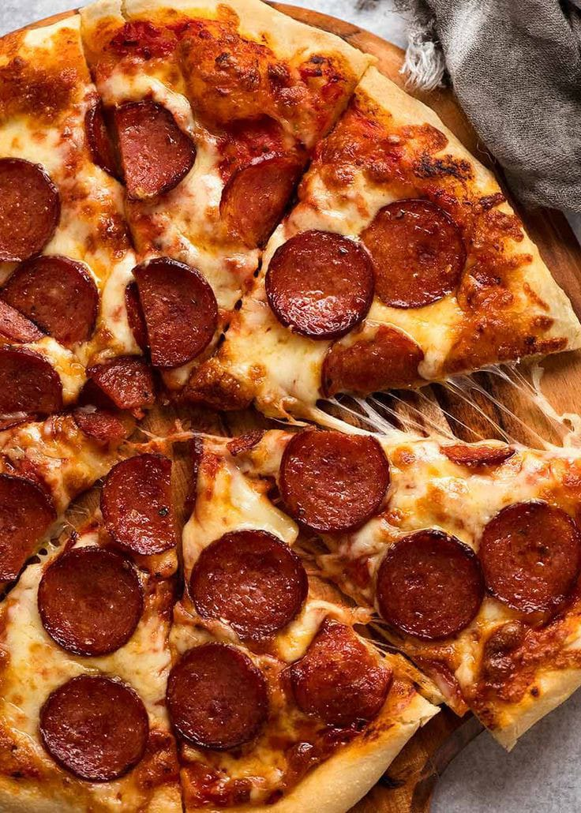

Scotch’s Pizza
SALES ANALYSIS REPORT
BY NWAJIAKU SHARON BUKKY
LAST UPDATED: 23RD JANUARY,2025

Slide 2
Scotch Pizza has strong sales performance, thanks to its unique value offer and commitment to quality. With established locations in four major cities, including Freeport, Ithaca City, Lancaster Town, and New York, the organization has successfully penetrated its target market. Effective marketing initiatives, efficient inventory management, and great customer service have all helped to drive significant revenue development. Scotch Pizza is positioned for continued growth and revenue improvements.

Slide 3
Branch Showdown: Who’s Leading the Pizza Game?
Most Popular Branch
Top Performer: "House of Pizza" leads as the most popular branch, showcasing its superior customer engagement or strategic location.
Performance Gap: "Thomas House" lags significantly, indicating potential operational inefficiencies or a need for better marketing.
Recommendation: Replicate the success strategies of "House of Pizza" in the “Thomas House”.

Slide 4
Pizzas That Keep Customers Coming Back
Scotch Pizza's Top 5 Faves
The "Barbecue Chicken Pizza" is the highest-selling item, significantly outperforming other pizzas. "The California Chicken Pizza" and "The Classic Deluxe Pizza are close competitors.
Recommendations: Run targeted marketing campaigns for these top pizzas to sustain their popularity and introduce combo deals that include less popular options.

Slide 5
Timing is Everything: When Pizza Lovers Flock In!
Peak Customer Influx
Lunchtime is the most crucial time of day because of the biggest consumer traffic at 12 PM (3,345 orders) and 1 PM (3,240 orders). This suggests that there is a high need for quick and easy food options. Focus on advertising combo packages, lunch specials, and quick service to take advantage of this and satisfy the rush. Evening hours are particularly busy around 6 PM (2,732 orders) and 7 PM (2,192 orders), which makes them perfect for upselling high-margin products like drinks, desserts, and premium pizzas. On the other hand, low-traffic times like 9 AM (two orders) and 11 PM (27 orders) offer chances to draw clients with focused marketing campaigns like "Early Bird Discounts" or late-night deals. Furthermore, increasing marketing initiatives for mid-afternoon times such as 2:00 PM (1,768 orders) could help balance the flow of customers throughout the day, improving overall sales performance.

Slide 6
Sizing Up the Customer’s Choice
Customer Preference for Value: Sales of large pizzas are the most common, suggesting that customers strongly desire value and sharing choices, which is probably due to purchases from families or groups. Growth Potential in Smaller Sizes: Since small and medium sizes account for a smaller percentage of sales, there may be a chance to provide meal bargains or combos to single consumers or smaller groups. Specialized Demand: XLarge and XXLarge pizzas serve a particular market but have high-profit prospects. Promoting these sizes strategically at parties or events could result in more income.
Top-Selling Pizza Sizes

Slide 7
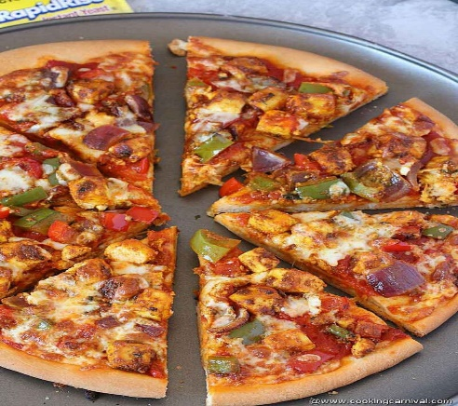


END OF PRESENTATION
THANK YOU!

